Slide 1
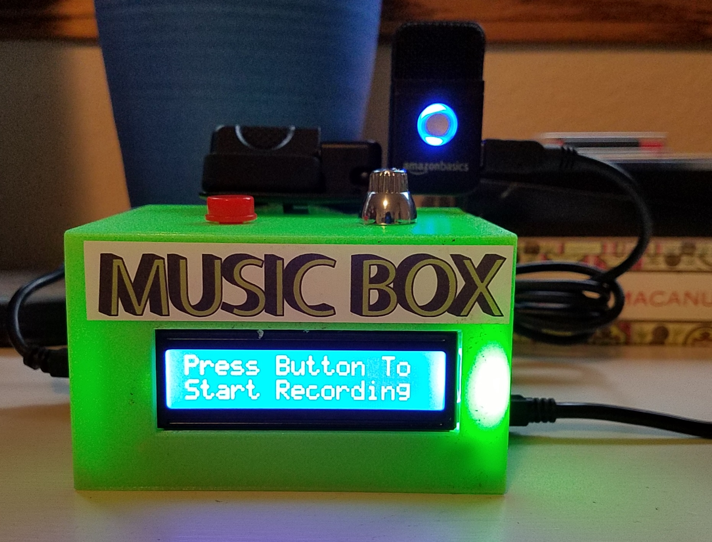
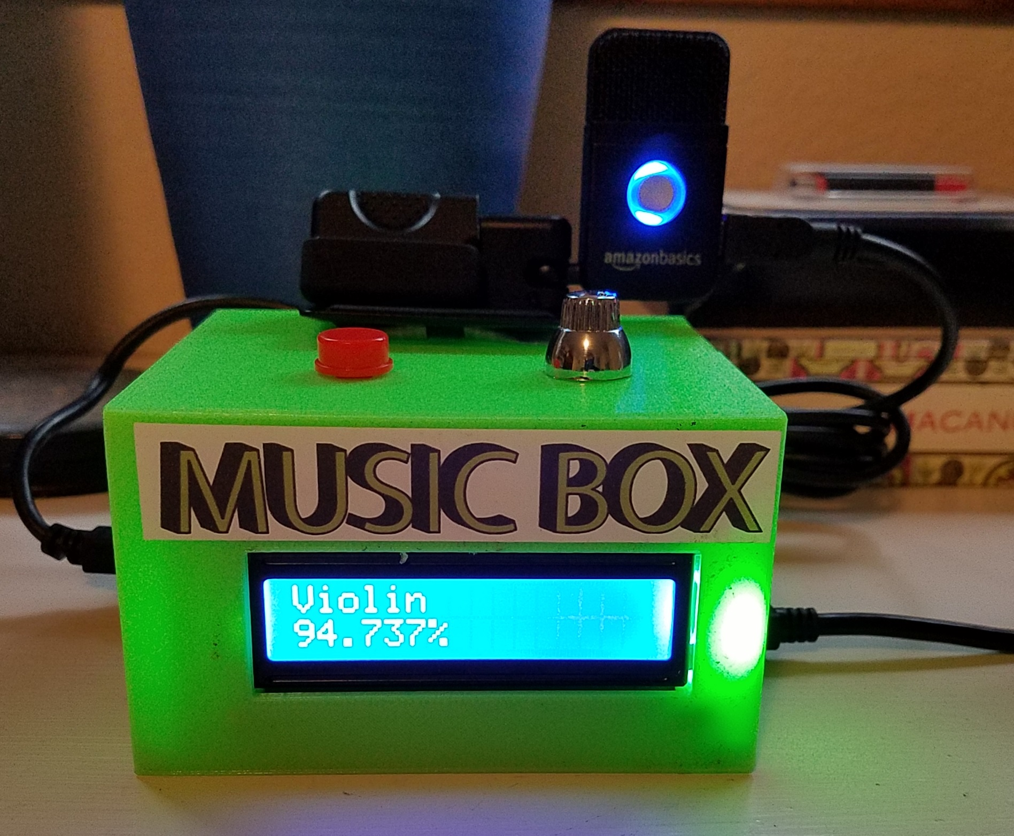
Support Vector Classification of Musical Instruments
Thomas Martin & Daniel Salazar
CSU East Bay
CMPE 344
Notes:
Thomas and Daniel

Slide 2
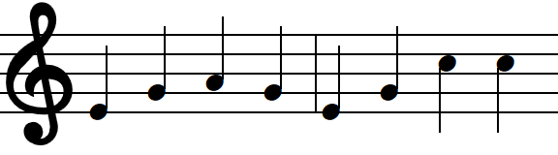
Project Overview
Goal: Develop a stand-alone platform built around the Beaglebone Black to record live music and classify the instrument that is playing in real time.
Instrument Classification: Machine learning model developed to classify the instrument being played.
Data Set: 5,438 audio samples of 7 instruments retrieved from the Philharmonia orchestra used to develop the machine learning model.
Hardware Components: Beaglebone Black, Microphone, 16x2 character LCD, push-button, and 3D printed case used to construct the project.
Notes:
Daniel

Slide 3
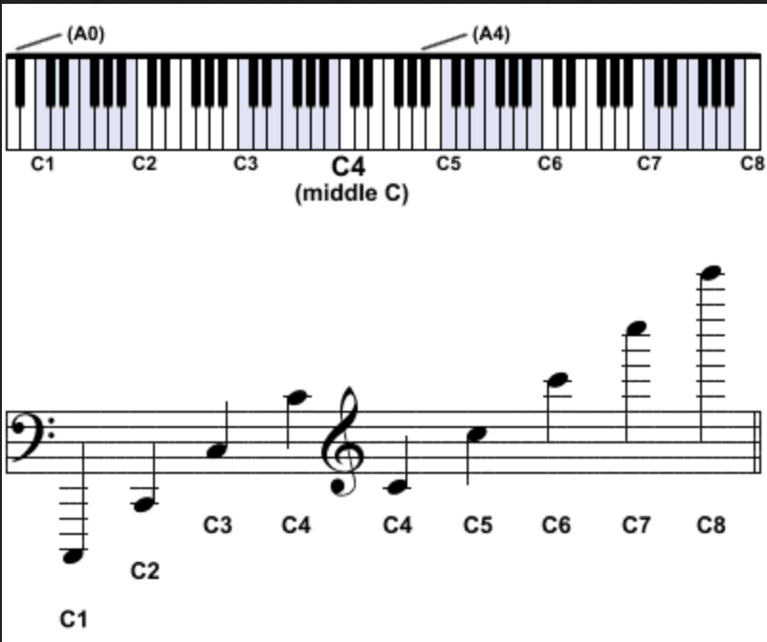

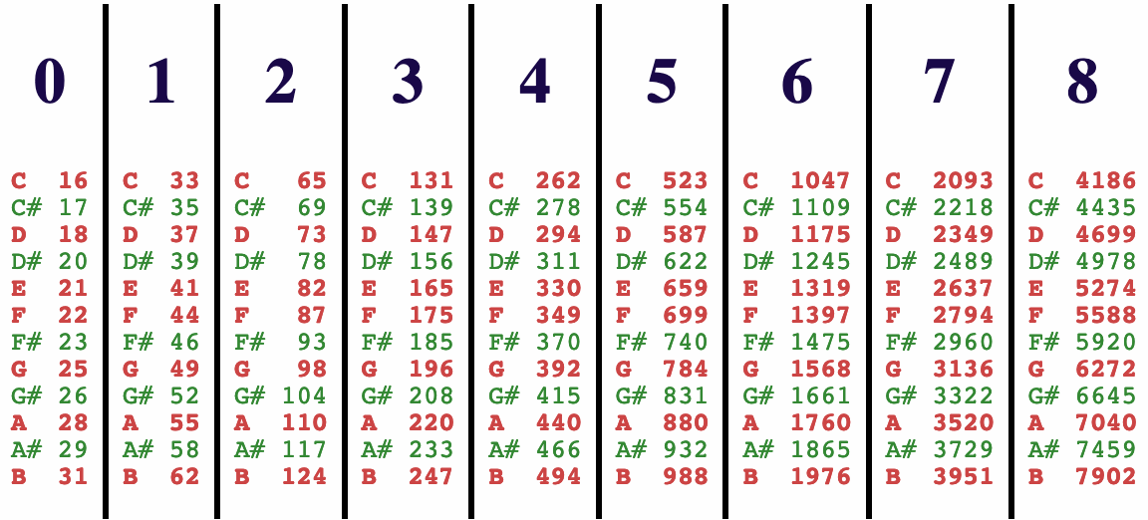
Feature Set
Project encompasses 7 features (instruments):
Cello (C2-C6)
889 audio samples
Clarinet (E3-C7)
846 audio samples
Guitar (E3-E6)
106 audio samples
Saxophone (Bb3-G6)
732 audio samples
Trumpet (F#3-D6)
485 audio samples
Violin (G3-A7)
1502 audio samples
Flute (C4-D7)
878 audio samples
Notes:
Thomas

Slide 4
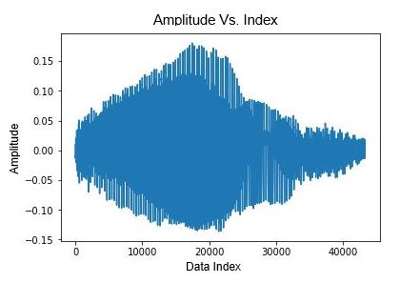
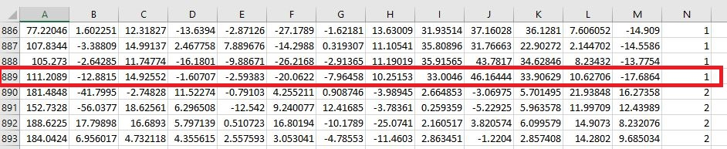
Machine Learning Workflow
Data Preprocessing
Convert .mp3 files to .wav files
Remove leading and trailing silence
Feature Extraction
Compute MFCC values (Mel Frequency Cepstrum Coefficients) for each audio sample and append instrument labels
Model Training
Support Vector Machine (SVM) model with RBF kernel
75/25 train-test split
Model Testing
93-97% accuracy with trained model on Philharmonia data
Model Persistence
Final model saved to ‘pickle’ file to ensure classification consistency among tests
Notes:
Thomas

Slide 5
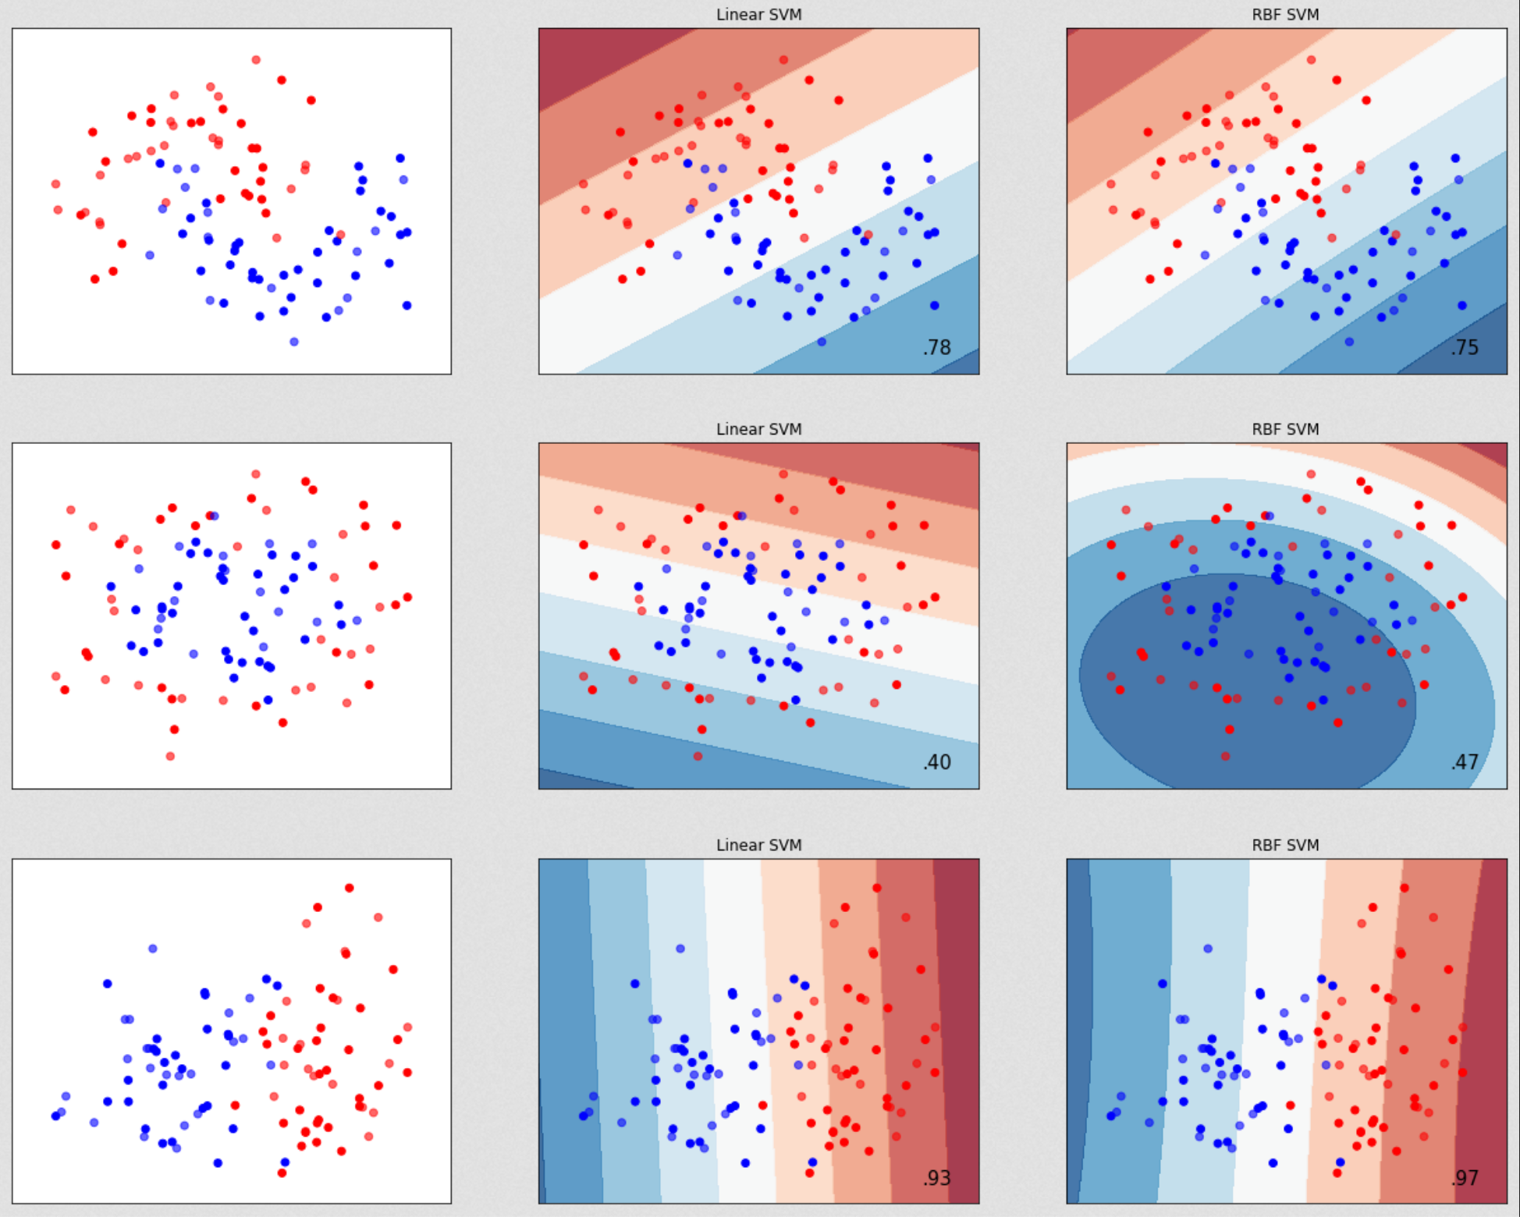
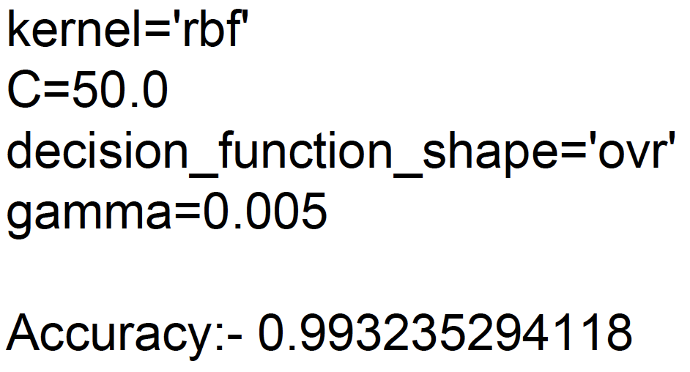
Machine Learning Model: SVM
The Support Vector Machine (SVM ) finds a linear separating hyperplane with the maximal margin in this higher dimensional space.
This Radial Basis Function (RBF) kernel nonlinearly maps samples into a higher dimensional space so it, unlike the linear kernel, can handle the case when the relation between class labels and attributes is nonlinear.
There are some situations where the RBF kernel is not suitable. In particular,
when the number of features is very large, one may just use the linear kernel.
Notes:
Daniel

Slide 6
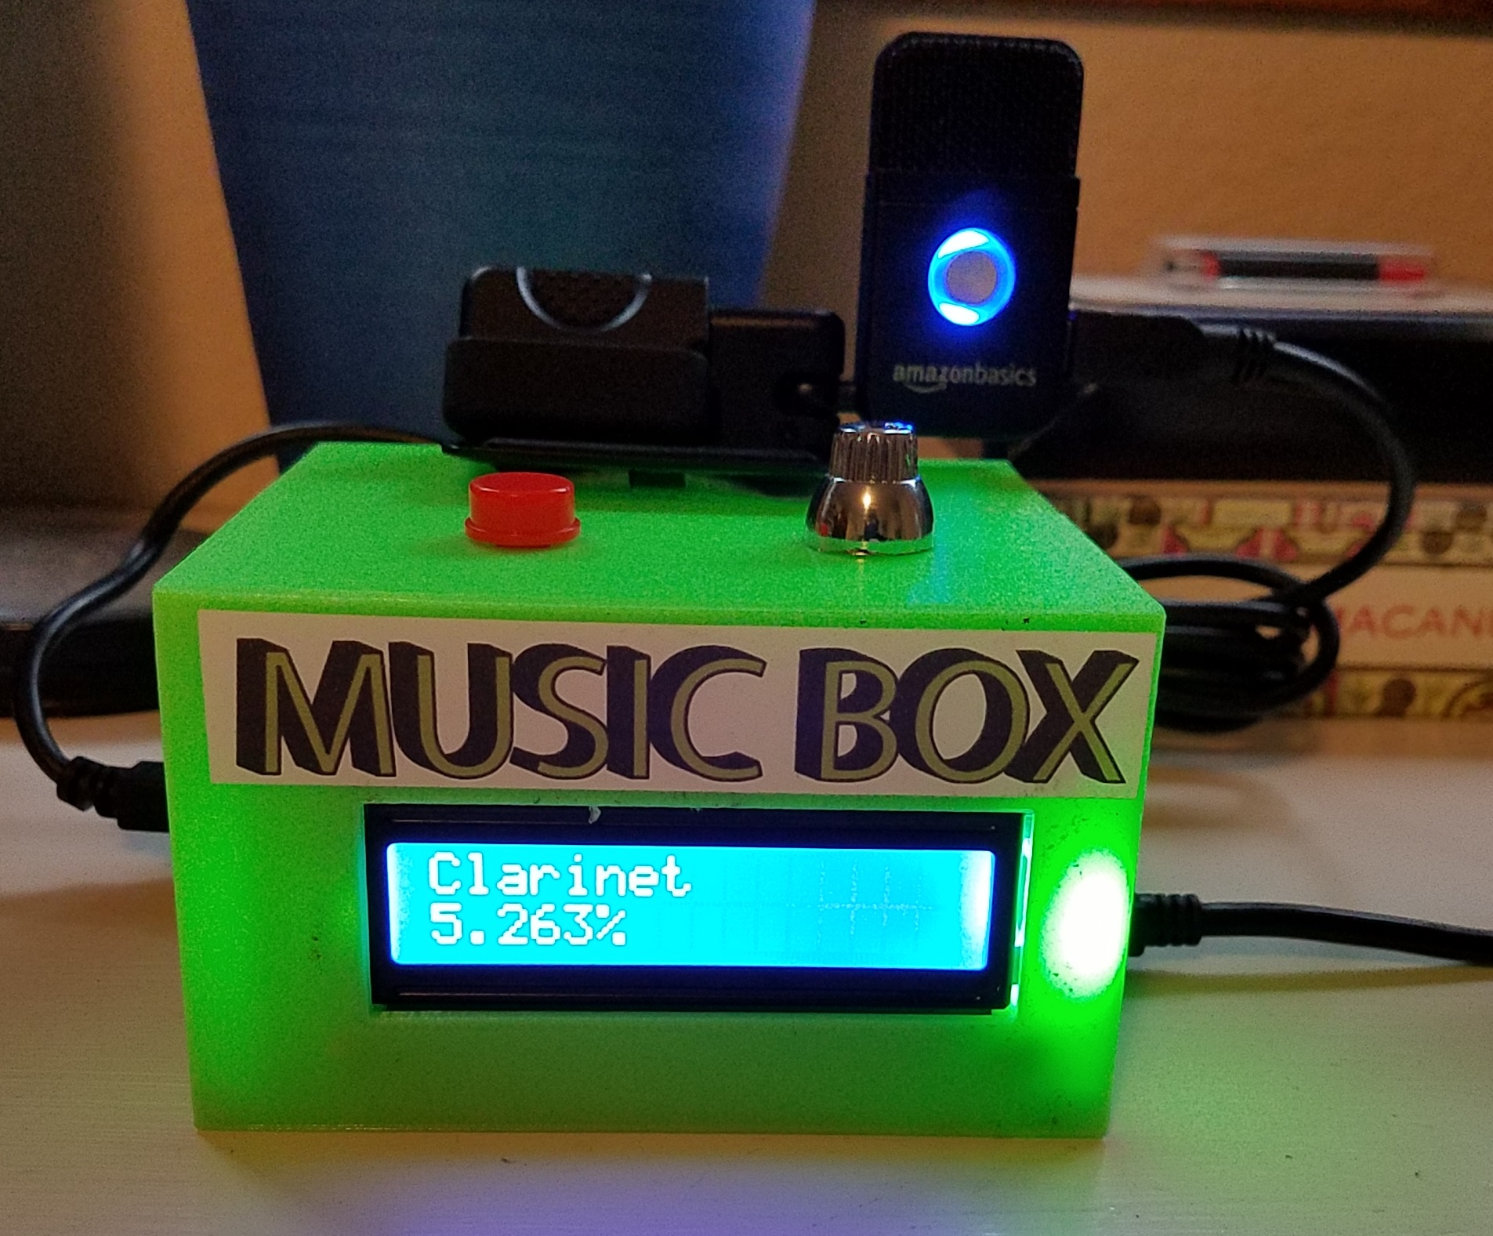
SVM Model & Audio Results
93-97% combined accuracy with all instruments when using MFCC values extracted from source audio files
When using the microphone to record audio data classification accuracy varies based on instrument
Instruments with a greater number of audio samples performed better
Most recognized instrument: Clarinet
Least recognized instrument: Guitar
Notes:
Daniel

Slide 7
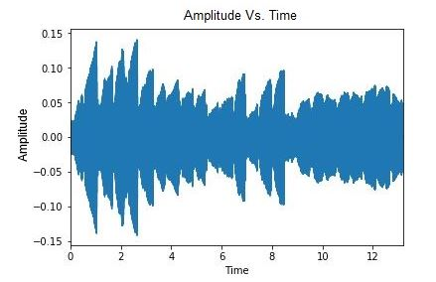
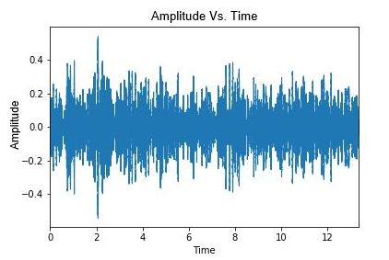
Microphone and Audio Analysis
Audio spectrogram of trumpet clip (Mezzo Forte Tenuto) from Philharmonia dataset (source)
Audio spectrogram of the same trumpet clip captured using the Beaglebone and USB microphone
Notes:
Thomas

Slide 8
Hardware Results
16x2 LCD provided effective means to convey instructions and errors to user
Simple potentiometer control for brightness
Wire soldering and management not as simple as I2C option
AmazonBasics microphone was not able to record high-quality audio data
Background noise readily audible
Simple USB interface and easy to troubleshoot
Push button
Controlling with Adafruit_BBIO.GPIO library was relatively straight-forward
3D printed case
Housed all hardware components well
10 hour print time
Notes:
Daniel

Slide 9
Improvement Opportunities
Hardware
Higher quality microphone
LCD with I2C backpack
Portable power supply
Software
Configure Python script to execute automatically upon system boot-up
Machine learning
Use larger source audio dataset for each instrument
Use the same number of audio samples for each instrument
Try other classification algorithms (KNN, random forest, SVM with linear kernel)
Train model with audio samples collected with the microphone used for eventual testing
Train model to classify all instruments
Notes:
Thomas and Daniel

Slide 10
Summary
Developed a Beaglebone-based platform with a SVM machine learning model capable of classifying 7 different instruments from music recorded using a USB microphone
Successfully created a stand-alone platform with a simple UI
High test accuracy achieved with source audio data
Test accuracy with USB audio data varied based on instrument
Improved test accuracy possible with changes to the audio hardware, machine learning model, and the source data set
Notes:
Thomas

Slide 11
Work Cited
Software Libraries
Scikit Learn - Support Vector Machines
https://scikit-learn.org/stable/modules/svm.html
Librosa - Music and Audio Analysis
https://librosa.github.io/librosa/index.html
Research Projects
Musical Instrument Classifiers
https://github.com/ArushiSinghal/Automatic-Instrument-Identification
https://github.com/IvyZX/music-instrument-classifier
Data Set
http://www.philharmonia.co.uk/explore/sound_samples
3D Printed Devices
1602A LCD Case
https://www.thingiverse.com/thing:1873666
Notes:
Thomas and Daniel

